Slide 1
Just Thought You’d Like to Know About Plants
Written by: J. Walters
March 24, 2008

Slide 2
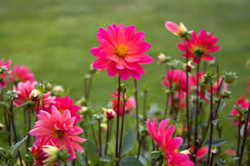
Plants have roots, a stem, leaves, flowers, and seeds.
Just thought you’d like to know.

Slide 3
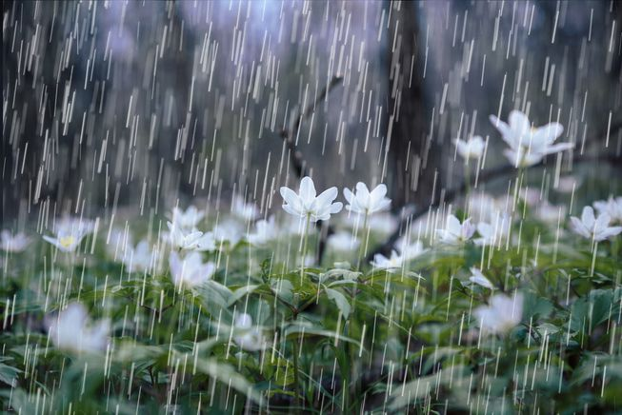
Plants need sun and rain to grow.
Just thought you’d like to know.

Slide 4
Most plants begin as a seed with a baby plant and food inside of it.
Just thought you’d like to know.

Slide 5
Plants make food of their own by using sunlight, water, carbon dioxide, and chlorophyll. Chlorophyll is found in plants’ leaves and gives them their green color.
Just thought you’d like to know.

Slide 6
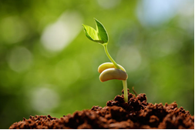
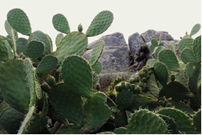
Plants can grow deep in the ground, in the ocean, or in the dry desert.
Just thought you’d like to know.

Slide 7
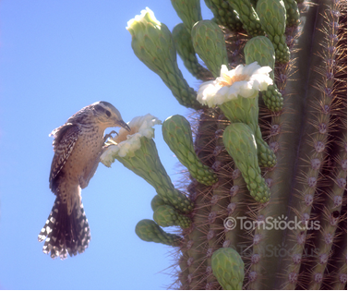
Some plants are food for animals and can be homes for them too.
Just thought you’d like to know.

Slide 8
Plants are the key to life on this earth!
Just thought you’d like to know.

